Slide 1
Career Pathways and the ESL Classroom
ESLPAC Conference
October 14, 2016

Slide 2
WIOA Languages Changes it All!
WIOA Requires us to:
Work with partners-Michigan Works, Michigan Rehabilitation Services, Colleges/Universities/Technical Schools
Utilize a Career Pathways system
Integrate ESL Civics (IELCE)

Slide 3
National Data
ESL Information
62% of the Foreign Born residents over the age of 16 are working
16.5% of all foreign born residents over the age of 25 have at least a bachelor’s degree
30% of all foreign born residents over the age of 25 have less than a high school degree.
American Community Survey

Slide 4
Michigan Data
ESL Information
52.5% of the Foreign Born residents over the age of 16 are working
40% of all foreign born residents over the age of 25 have at least a bachelor’s degree
22.5% of all foreign born residents over the age of 25 have less than a high school degree.
American Community Survey

Slide 5
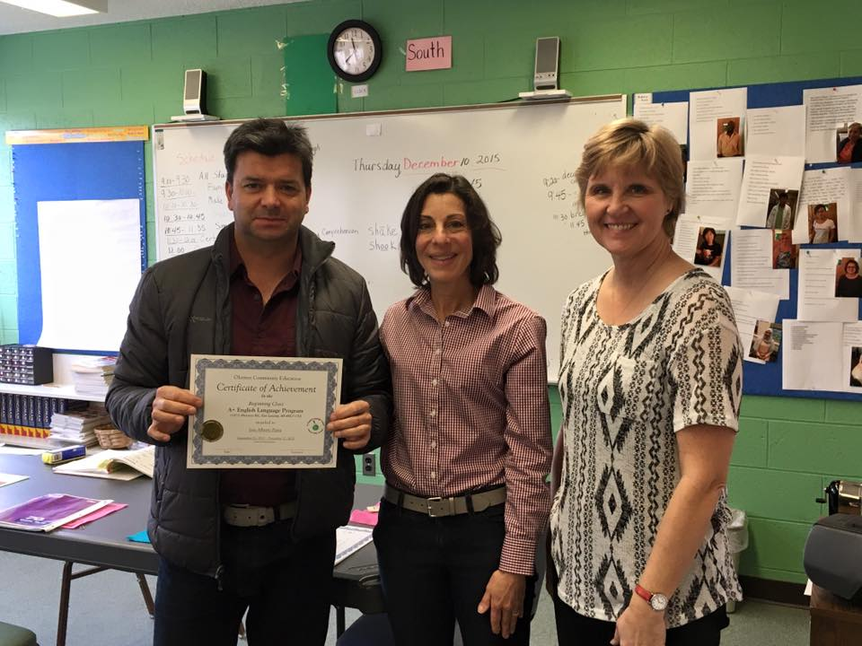
A Story of a student
Name: Jose Parra

Slide 6
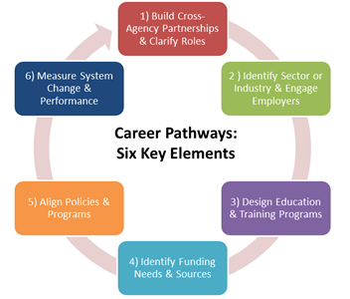
Career Pathways
6 elements

Slide 7
What is a Career Pathway?
The new way to teach ESL: A look at the top
True definition of a Career Pathways is a sequence of coursework that:
Aligns with the skill needs of industries in your region
Involves transition into post secondary, apprenticeship or trainings
Utilizes curriculum that is contextual to develop work readiness skills
Incorporates appropriate and integrated instruction to accelerate education
Leads to an attainment of an industry-recognized degree or credential
Helps worker enter or advance in a specific field
Includes academic and career counseling
Meets the needs of the student with help with barriers
Integrates Civics Education (IELCE)
Examples:
I-Best: 2 Pairs of instructors in the same classroom teaching a job
(CNA)
Alternating Teachers: Same as above but not at the same time
VESL/VABE: Students prepare to work in a specific field-Entire Class
Cluster VESL/VABE: Greater variety of students and goals in a class

Slide 8
The Classroom
What does it mean in the classroom?
Intense/streamlined classroom instruction
Development of soft skills need for employment
Sharing a vision and strategies with community partners and within a program
Career Pathway aligns with the Michigan Works/top regional sector industries
Integrate Employability skills
Prepare our students to be successful in post-secondary education
Use contextualized materials
Incorporates rigorous civics education
Include Career/Education next-steps

Slide 9
Putting Career Pathways to Work
Classroom Activities
Scavenger Hunt- Old Town
  Business
  Directional
Career Exploration- Healthcare
  Hospital vs. Office
  Men vs. Women
Career Interest Survey
Job Fair-Regionally
Pure Michigan Talent Connect and O*Net
Starting a business project

Slide 10
Okemos A+ English Language
Program
What are we doing?
Program Strategic Planning (Spring 2016)
Meeting with local industries to provide ESL classes:
Meijer
Peckham
Sparrow
Cameron Tool and Die Corporation
Looking at Employability Skills/Standards Kentucky Model template (Fall 2016) & incorporate it into classrooms studies to help with
ESL/employability and soft skills in the workplace (January 2017)
Shorter more intense classes
Utilizing CCRS and 180 Skills
Working with local business HR for interviewing skills
Working with Lansing Community College to create an academic bridge program/shared instruction

Slide 11
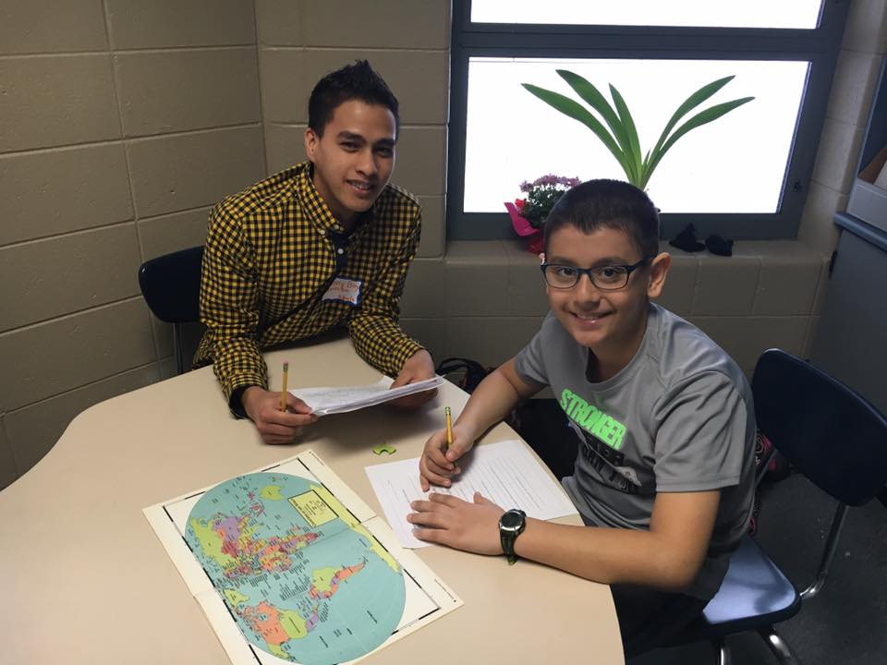
A Story of a student
Name: Danny Boy Quimba

Slide 12
Contact Information
Karyn Goven
Director
Okemos A+ English Language Program
karyngoven@gmail.com
Patrick Brown
Program Specialist
Okemos A+ English Language Program
Patrick.brown@okemosk12.net

