Slide 1
Integrating Civics
Michigan
ESL Professional Advisory Committee
Rebecca Schwartz, Karyn Goven, & Patrick Brown

Slide 2
Agenda
Civics Question
Civics Integration
Scaffolded Lessons
Civics Resources
Comments & Suggestions

Slide 3
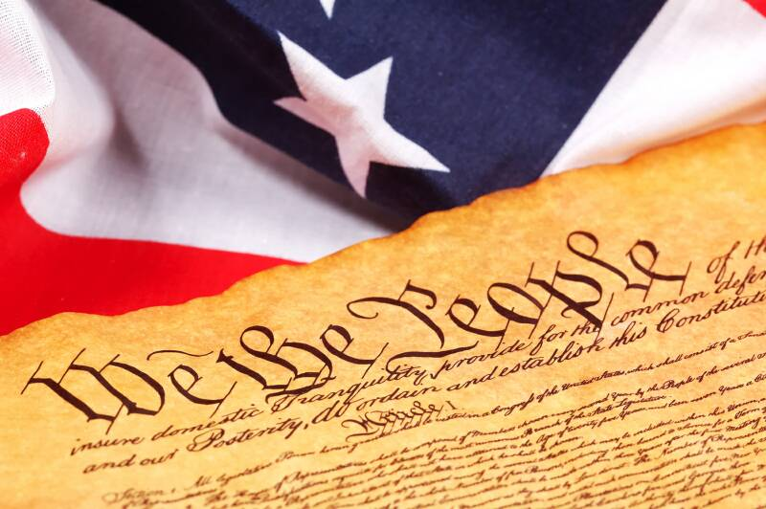
Civics Question When was the Constitution written?
1776
1787
1792

Slide 4
2) Civics Integration
Federal WIOA:
ESL services must help participants
gain the skills needed to function
effectively as parents, workers, and
citizens in the United States.

Slide 5
Integrated English Literacy and Civics Education (IELCE) Services must include instruction in:
Literacy and English language acquisition
Rights and responsibilities of citizenship and civic participation
Workforce Training

Slide 6
From 2009-2014, over 4.2 million people were naturalized
Promotes instruction and training about the rights and responsibilities of U.S. citizenship
Provides permanent residents with information and other tools for integration into American culture

Slide 7
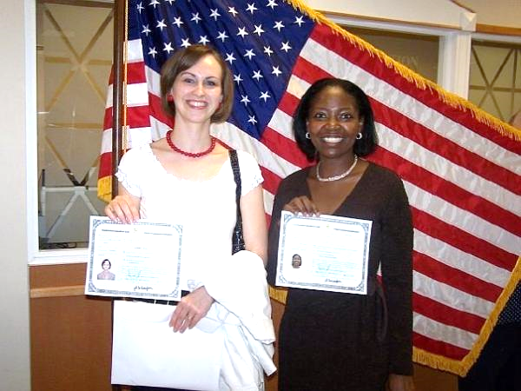
The U.S.
Citizenship
Test
Emphasizes the founding principles of American democracy and the rights and responsibilities of U.S. citizenship
Incorporates reading, writing, and interviewing skills

Slide 8
How do we connect it all? Civics Integration Table
ESL PAC has created this useful tool using the 100 question
U.S. Citizenship Test.

Slide 9
Civics Integration Table
Easy to read
Can be scaffolded for different levels
Incorporates the College and Career Readiness Standards (CCRS)
Aligns with the U.S. Citizenship Test
Includes helpful resources

Slide 10
Civics Integration Table 100 question U.S. Citizenship Test
Question | Emg | Beg | Int | Adv
97. Why does the flag have 50 stars? There are 50 states today. | * | * | * | *
Teach to all levels.

Slide 11
Civics Integration Table 100 question U.S. Citizenship Test
Question | Emg | Beg | Int | Adv
5. What do we call the first ten amendments to the Constitution? The Bill of Rights |  | * | * | *
Teach to beginning, intermediate and advanced levels.

Slide 12
Civics Integration Table 100 question U.S. Citizenship Test
Question | Emg | Beg | Int | Adv
49. What is one responsibility that is only for United States citizens? Serve on a jury. Vote in a federal election |  |  | * | *
Teach to intermediate and advanced levels.

Slide 13
Civics Integration Table 100 question U.S. Citizenship Test
Question | Emg | Beg | Int | Adv
35. What does the President’s Cabinet do? Advises the President |  |  |  | *
Teach to the advanced level.

Slide 14
Implementing the Civics Integration Table
Emergent & Beginning Levels
Readers need concrete representations of new concepts
and information.
Not all levels need to master all 100 questions because they are repeated throughout levels.
Intermediate Level
Readers can pass the test with
understanding.
Advanced Level
Readers gain mastery of concepts.

Slide 15
3) Scaffolded Lessons
Levels Components
Advanced
Warm Up
Reading
Speaking
Writing
Project
Intermediate
Beginning
Emergent

Slide 16
Lesson Objectives from U.S. Citizenship Test The American Flag
64. Name three of the
original 13 states.
(Intermediate &
Advanced Levels)
96. Why does the flag
have 13 stripes?
There were 13 original
colonies/states.
97. Why does the flag
have 50 stars?
There are 50 states today.

Slide 17
Emergent and Beginning Levels
The American Flag Lesson

Slide 18
Emergent Level
Reading/Speaking/Writing:
Colors: red, white, & blue
Shapes: star, stripe, & square
Vocabulary: flag, state
History: U.S. began with 13 states
Map skills: Show map of 13 states
Warm up:
Show a U. S. Flag
Where do you see the U. S. flag?
(School, post office)
Project:
Color a U.S. flag

Slide 19
Beginning Level
Reading:
Use USCIS Beginning Level Handout
Vocabulary: Definitions
Speaking:
Pronounce new words.
Read sentences aloud.
Project:
Students draw a picture of their country’s flag and describe it using colors and shapes.
Writing:
Write simple sentences about the flag using new words.
Warm up:
Show a U. S. Flag.
Where do you see the U.S. flag?
(School, Post office)

Slide 20
USCIS Beginning Level
The American flag is an important symbol of the United States.
The flag has 13 red and white stripes.
The stripes represent the 13 original colonies.
There are 50 stars on the flag.
Each star represents a state.
Our national anthem is about the American flag.
The name of the national anthem is “The Star-Spangled Banner.”
The Star-Spangled Banner was written in 1814.

Slide 21
Civics Answer When was the Constitution written?
1776
1787
1792

Slide 22
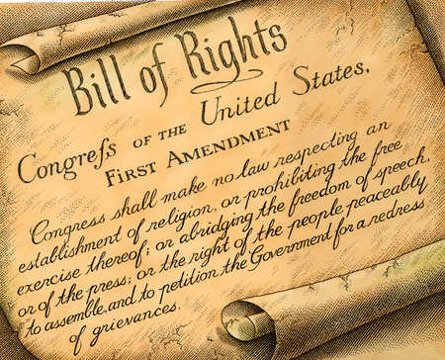
Another Civics Question How many amendments does the Constitution have?
25
27
29

Slide 23
Intermediate and Advanced Levels
The American Flag Lesson

Slide 24
Intermediate Level
Speaking:
Practice saying the states with stressed syllables (Mas-sa-CHU-setts)
Compare and contrast the U.S. flag and their country flag
Reading:
USCIS Intermediate Level Handout
Vocabulary: Divide into syllables
Learn the names of the first 13 states
Label the states on a map
Comprehension Questions
Project:
Show their country’s flag to the class and explain the meaning
Writing:
Write a sentence using each new word
Write a paragraph about the U.S. flag
Warm up:
List what students know about the U.S. flag.

Slide 25
USCIS Intermediate Level
The first American flag became official in 1777. The first flag had 13 stripes and stars to represent the 13 original states. Those states were colonies before the colonists declared independence from Great Britain in 1776. The colonists fought the British because they wanted self-government and freedom to make their own decisions.
Over the years, our flag has changed depending on the number of states in the country. There have been various versions of the flag. Today our flag has 13 red and white stripes to represent the 13 colonies. The 50 stars on the flag represent the 50 states. Every year on June 14, we recognize the American flag on Flag Day.

Slide 26
Advanced Level
Reading: 2-3 page article
Scan
Skim
Define using context
Define in English. No translation!
Comprehension Questions
Project:
Students from the same country give an audiovisual report to the class about the history and meaning of their flag.
Warm up:
List what students know about
the U.S. flag.
Writing:
Research and write a report about their country’s flag with history and meaning of colors, symbols and words.
Speaking:
Read paragraphs aloud in a small group
Discussion Questions

Slide 27
Design Lessons for Your Class
How many students?
Which countries?
Level of Education?
Refugees, immigrants, and/or
university students?
% Interested in U.S. Citizenship?

Slide 28
Possible units to teach about
the American Flag
Welcome to the U.S.A.
Community Unit: Post office, courthouse
Symbols of America
Government Unit
Flag Day – June 14

Slide 29
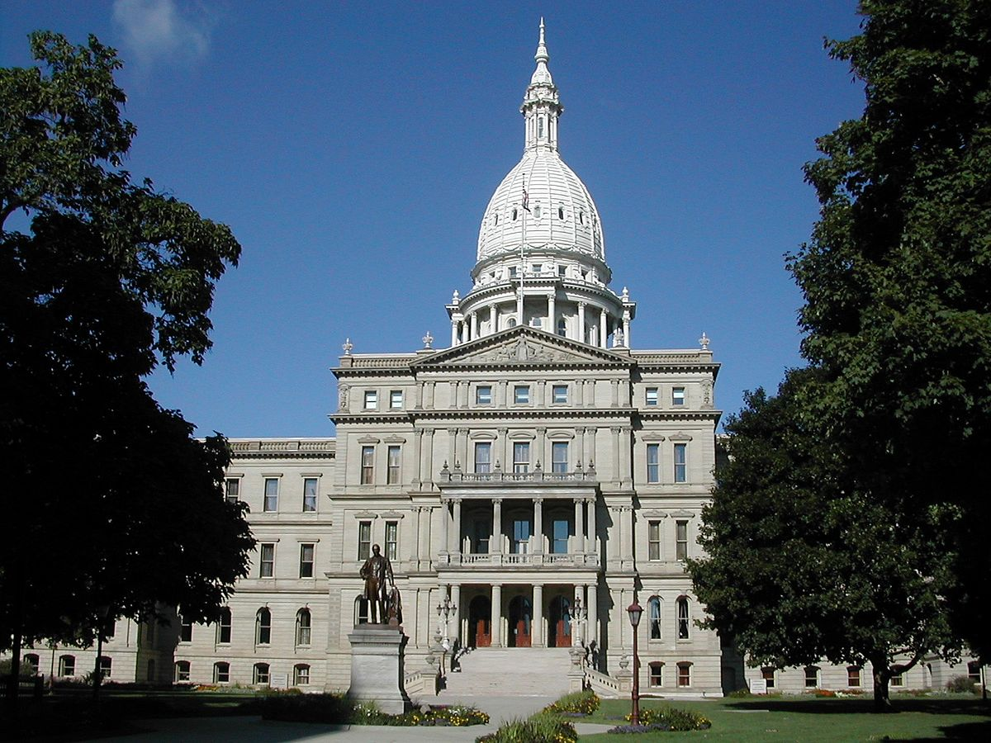
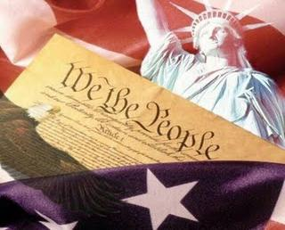
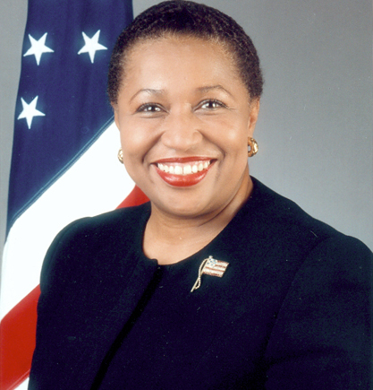
Other Examples of Civics Integration
Have USCIS visit to talk about the naturalization process.
Conduct mock naturalization interviews.
Invite your representative to talk about their job.
Visit a historical landmark and have students tell what they learned.
Conduct a mock Senate
Create a “Class Constitution”
Visit a polling station at election time.
Representative
Sam Singh

Slide 30
Civics Answer How many amendments does the Constitution have?
25
27
29

Slide 31
4) Civics Resources: Websites
USCIS website: Citizenship information; Teacher lesson plan ideas, etc. https://www.uscis.gov/citizenship
Michigan Immigration Rights Center: Rights and support for immigrants
http://michiganimmigrant.org/
Marshall Adult Education: civics articles, biographies
http://resources.marshalladulteducation.org/

Slide 32
www.Americaslibrary.gov Resources for American historical events, government etc.
www.Goverment.mrdonn.org Easy lesson plan ideas, power points and ideas, etc.
www.Ducksters.com For advanced level: Historical articles, biographies, etc.
Burlington English - Online software for English language learners

Slide 33
Civics Resources: Books
Voices of Freedom, by Bill Bliss, Pearson Education, 2009.
Citizenship Now, by Karen Higleman, McGraw-Hill. 2008.
Future U.S. Citizens, Pearson Education, 2011.
Citizenship: Passing the Test, Lynne Weintraub, New Readers Press, 2016.

Slide 34
Thank you for viewing!
ESL Professional Advisory Committee
Facebook and Twitter!
www.eslpac.weebly.com
mieslpac@gmail.com
Michigan

Slide 35
5) Comments
And
Suggestions
send to
mieslpac@gmail.com

