Slide 1
Community in the classroom
Joy Shantz
Nicole namy
Office for international students and scholars
MichIGAN STATE UNIVERSITY

Slide 3
Objectives
Reflect upon personal cultural values
Share successful OISS programs and philosophies
Brainstorm tactics for your classroom community
Pair and share action worksheets

Slide 4
Personal Mapping Exercise
Personal mapping is the process of identifying, recording and assessing personal and cultural values.
All the experiences we have growing up have contributed to who we are today, particularly in terms of what we value, what we believe, what we know, and how we behave.

Slide 5
Directions
Take a few moments to complete this diagram. In as many circles as you can, write a word you feel describes you or is a significant part of who you are or how you choose to identify yourself to others (e.g., sister, student, teacher, Asian, religious affiliation, political affiliation).

Slide 6
More Directions
Now, add some values you attribute to the circles.
For example, values from being a student might be “independence,” “respect for knowledge,” or “question authority.”

Slide 7
Small Group Reflection
If you had to pick just one circle, which would it be? Two circles? Why are these the most important parts of your cultural identity?
How do these circles change when you are within your different social circles?
What insights can you gain about yourself in completing the personal mapping exercise?
How might your values be impacting your work with students, staff and faculty?
What value difference have you encountered in your own work?
Based on your circles, how might others perceive you?

Slide 8
Positionality
Definition:
Reflection:
Positionality refers to ones social location or position within an intersecting web of socially constructed hierarchical categories such as race, class, gender, sexual orientation, religion, nationality and physical abilities to name a few.
Consider how your postionality impacts your experiences, understanding, and knowledge about yourself and the world around you. How does your postionality impact your intercultural communication interactions?

Slide 9
Mapping Debrief
One challenge is that you may only be seen as a U.S. American, male/female, Korean, etc.
Similarly it is important to realize that all people are complex and have multiple layers of identity
Just as you don’t have one identity, don’t fall into a trap of limiting others to one identity.

Slide 10
Connecting to community building:
How can this support student community building in the classroom?
What might you gain from knowing this information about your students? What might they gain from knowing this information about each other?

Slide 11
Our population

Slide 12
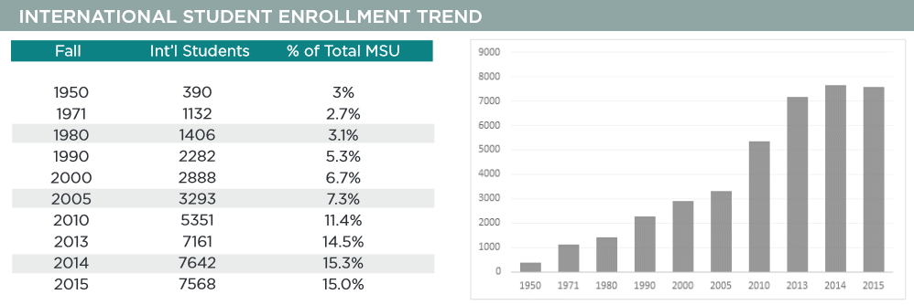

Slide 13
Acculturation issues
Microaggressions
Assumptions about race/culture
Language barriers
Exclusion or separation by country of origin
Academic and social pressure
*summarized from one residence hall survey taken in Fall 2016

Slide 14
Our programs
Service Learning
Extended International Academic Orientation Program (EIAOP)
Coffee Hour & EL Scavenger Hunt
Field Trips

Slide 15
Service Learning
Center for Service Learning and Civic Engagement: -connects students and all MSU community
with service projects -academic or co-curricular
Example: Indian Student Organization’s Gandhi Day of Service
-diverse population of students
-sharing heritage and experience
-serving Refugee Development Center in Lansing

Slide 16
Extended International Academic Orientation Program (EIAOP)
IAOP 2016
One week program
EIAOP
Spans fall semester
-Required attendance at events
-Variety of options
“Make connections, achieve student success”

Slide 17
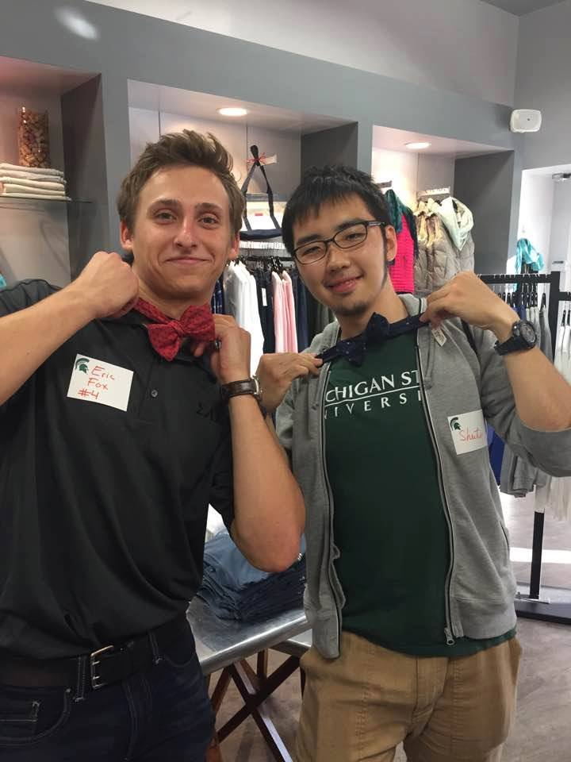
OISS Coffee Hour
-Shared experience
-Simple and reliable
-Sets expectation of attendance
-Bonding through activities
Example: Downtown East Lansing Scavenger Hunt 10/7/16
-diverse group of students
-sharing knowledge and experiencing downtown EL
-framing activity

Slide 18
Field Trips
-Shared experience
-New environment for everyone
-Educational and fun
Example: Sledding at Frandor Hill
-close by
-culturally relevant and unique activity
-low cost, limited planning required

Slide 19
Reflection
Over what experiences or similarities could your students form community? [Think OUTSIDE of language and culture]
What is holding them back?

Slide 20
Worksheet & Discussion

Slide 21
Q & A

