Slide 1
Team Teaching in the Classroom
It’s easier than you think!

Slide 2
Session Objectives
You will…
understand the rational for why team teaching is beneficial
learn how it can be implemented
see an example of Team Teaching in action
see how to determine a team teaching topic or focus
have the opportunity to ask questions
have the opportunity to get started

Slide 3
Rationale
Providing multi level ESL students the opportunity to learn and practice together
Develop learning relationships
Partner and small group work
Additional opportunity for speaking and understanding English
Students benefit from and establish familiarity with both teachers
Provides variety in ways of learning English
Peer support, encouragement and motivation
Teachers spark ideas for each other. Two heads are better than one!
It’s fun and gratifying for the students and teachers!

Slide 4
Implementation
Be intentional – Your weekly structure, thinking and organization support team teaching!

Slide 5
Implementation
Establish a common syllabus – not necessarily identical

Slide 6
Implementation
Lynn’s Emergent English Class
Weeks 3, 4 & 5 – Community Resources
[Text: TO: 9, 12; AS: 2; V:5]
Topic/Vocabulary: Around Town (maps, directions), Transportation, Destinations.
Grammar: Questions with Do/Does, Where, How. Using There is, There are. Prepositions of location (next to, on, across from, between), Transportation in/on.
Speaking/Listening: Ask and answer questions of related to the location of a person or place. Describe a neighborhood or location.
Phonics / Pronunciation: Letter names and sounds: d,n,r,g,t,l, long vowels: o, i
Writing/Reading: Read / write words and simple sentences with long o and I words. Write about own street. Read signs and a map. Capitalization and punctuation.
Career Connection: Jobs in the community and jobs related to transportation
Renee’s Beginning English Class
Community Resources
Week 3 Maps and Directions (All Star unit 2, Ventures unit 5)
Skills and Activities- giving/getting directions, naming buildings and places, reading, drawing, interpreting maps
Career Connections- DMV –getting a driver’s license
Week 4 Transportation
Skills and Activities-using public transportation to reach destinations, using geographical directions (N, S, E, W), learn about public services, traffic and street signs, addresses. phone numbers
Career Connections- reading/using time schedules, getting a library card
Week 5 Destinations
Skills and Activities- public vs. private locations, find/use community resources, practicing skills from weeks 3,4
Career Connections- the importance of being punctual

Slide 7
Implementation
Establishing a common planning time for Teaming
Determine logistics of space to accommodate joint classroom activities.
Decide on frequency, and time for the classes to come together.
Get your feet wet…start small.

Slide 8
Implementation
Example of lesson plan page with team times:

Slide 9
What Are the Skills and Topics?
Back to our common syllabus…
standards from syllabus (CCRS)
Speaking and Listening: (SL. K.2-3, 1.1, 1.4, 1.6) using listening / speaking etiquette rules, asking and answering questions, forming sentences, saying words correctly so others can understand (pronunciation).
Reading: (RI/RL.1.1, 2.1, RI.1.2, 1.7, RF.K.2 & 1.2) segmenting and blending sounds and syllables in words, decoding words and learning the meaning of new words, gathering meaning from a written text.
Writing: (W.1.3, 1.4, 1.6, 1.8, L.K.2 & 1.2) putting words into sentences and questions; using grammar and punctuation, putting thoughts or information into writing; spelling common sound patterns.
Grammar: (L.K.1 & 1.1) using common, proper and possessive nouns, using singular and plural nouns with matching verbs, using personal, possessive, indefinite and demonstrative pronouns, using past, present and future tense of verbs, using common adjectives, conjunctions, articles, prepositions, and using question words (interrogatives).
Numeracy: (l.NBT.2, 1.4, 1.5; 1. OA.2, 1.6, 1.8; 1MD.2, 1.4) counting, cardinality, number sense, number operations, developing an understanding of measurement and interpreting simple graphs/data.
Standard Outcomes
Reading (RI 1.1-1.9)
main topic, key details, connecting information in texts, identifying and using text features to comprehend, asking and answering questions related to content, finding textual evidence to support answers
Writing (W1.3-1.8)
explanatory, narrative and “how to” including topic, related sentences to form a paragraph on a topic, supporting details, closure, transitional words, sequence, graphic organizers, lists, note taking, completing forms, using technology in writing
Speaking and Listening (SL1.1-1.6)
responding, adding information to conversation, clarifying by asking, describing, speaking audibly, expressing ideas clearly and in complete sentences, when appropriate, recognize/use basic grammar conventions for understanding and speaking, recognize/use present, past and future tense, use sequence of events, follow multi- step directions
Language/ Grammar (L1.1-1.6)
nouns, verbs, adjectives, conjunctions, question words, sentence types, capitalization, punctuation, commas, spelling patterns, sorting, attributes, real life word connections, role playing word meanings
Reading Foundations (RF 1.2-1.4)
rhyming words, short/long vowels, consonant blends and digraphs, blending and segmenting syllables, decoding, high frequency sight words, irregular words, spelling
Numeration (2NBT .1-.8, 3NBT .1-.3)
Numbers and operations using base 10, measure in standard units, interpret data using graphic organizers

Slide 10
CCRS – College and Career Readiness Standards
www.vrae.org
https://lincs.ed.gov/publications/pdf/CCRStandardsAdultEd.pdf

Slide 11
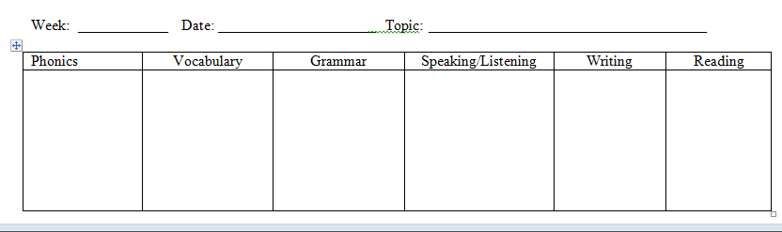
What Are the Skills and Topics?
Addressing different levels, intentional vs random pairings
Selecting targets - lesson plan page top portion

Slide 12
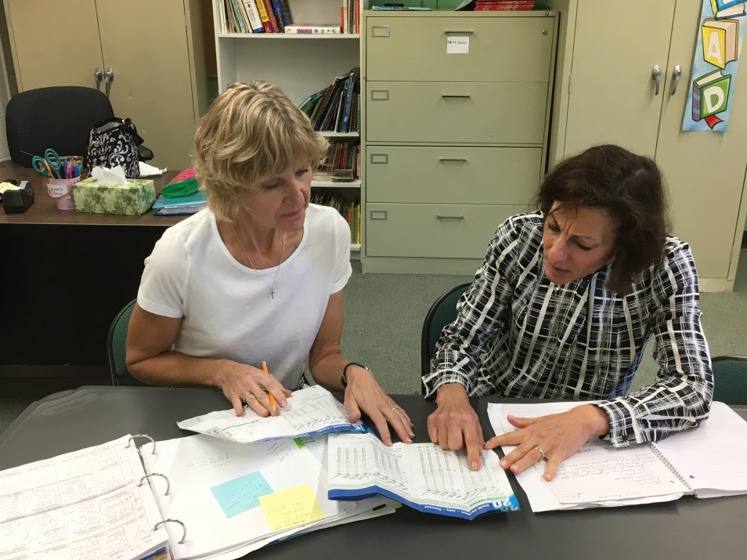
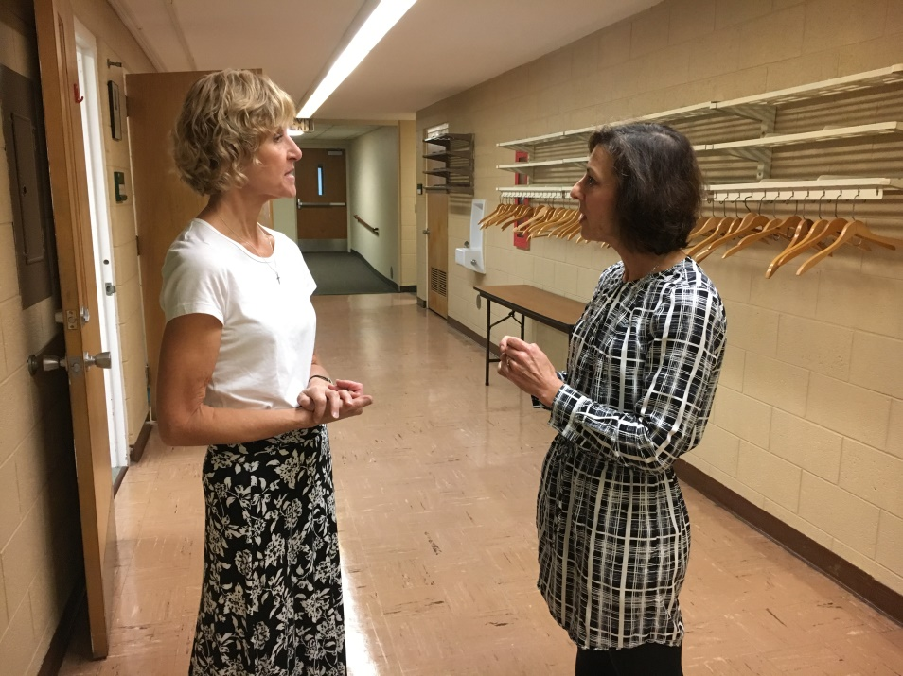
What it looks like in action!
Planning together – formally and informally (insert picture)

Slide 13
Keeping in mind our desired outcomes
Lynn’s Emergent English Class
Weeks 3, 4 & 5 – Community Resources
[Text: TO: 9, 12; AS: 2; V:5]
Topic/Vocabulary: Around Town (maps, directions), Transportation, Destinations.
Grammar: Questions with Do/Does, Where, How. Using There is, There are. Prepositions of location (next to, on, across from, between), Transportation in/on.
Speaking/Listening: Ask and answer questions of related to the location of a person or place. Describe a neighborhood or location.
Phonics / Pronunciation: Letter names and sounds: d,n,r,g,t,l, long vowels: o, i
Writing/Reading: Read / write words and simple sentences with long o and I words. Write about own street. Read signs and a map. Capitalization and punctuation.
Career Connection: Jobs in the community and jobs related to transportation
Renee’s Beginning English Class
Community Resources
Week 3 Maps and Directions (All Star unit 2, Ventures unit 5)
Skills and Activities- giving/getting directions, naming buildings and places, reading, drawing, interpreting maps
Career Connections- DMV –getting a driver’s license
Week 4 Transportation
Skills and Activities-using public transportation to reach destinations, using geographical directions (N, S, E, W), learn about public services, traffic and street signs, addresses. phone numbers
Career Connections- reading/using time schedules, getting a library card
Week 5 Destinations
Skills and Activities- public vs. private locations, find/use community resources, practicing skills from weeks 3,4
Career Connections- the importance of being punctual

Slide 14
Community Resource Unit
Broken down into three sub units over three weeks:
Destinations – Places around town
Maps and Directions
Transportation

Slide 15
Examples of Team Activities

Slide 16
Destinations
We divided the students into small groups and walked to five local destinations focusing on location prepositions and directional words.

Slide 17
Destinations
Students were encouraged to use the prepositional and directional words we had been practicing in the classroom as we walked to each location. This provided a real life opportunity to practice their skills.

Slide 18
Maps and Directions
For this activity we randomly divided the students into two groups. In Lynn’s group students were practicing naming locations and giving directions using a mock 3D town.

Slide 19
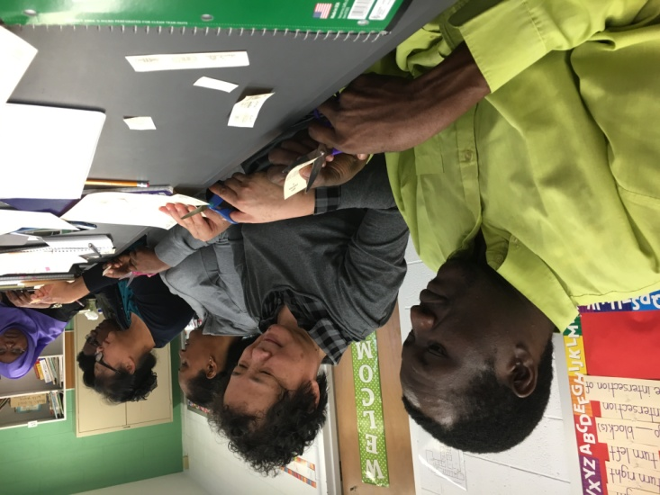
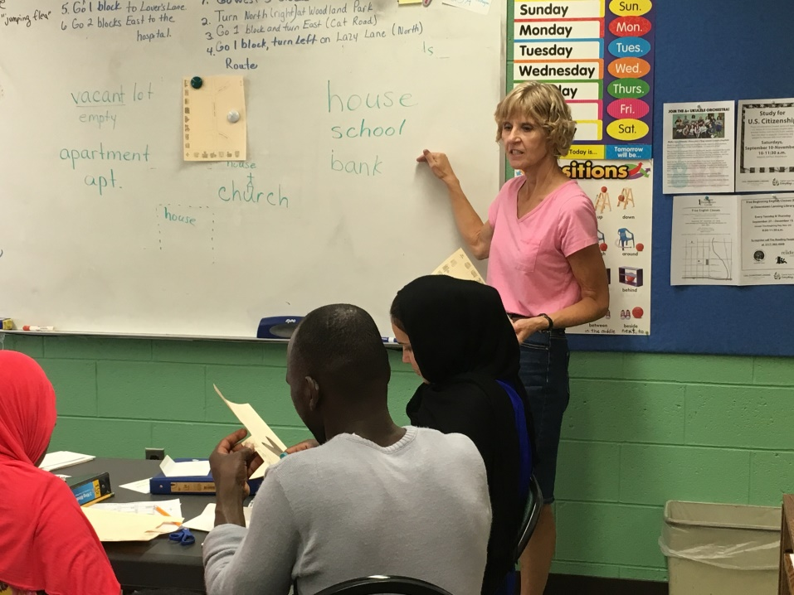
Maps and Directions
This activity was scaffolded.
First students cut out and learned the names of pictures of common locations in a city.

Slide 20
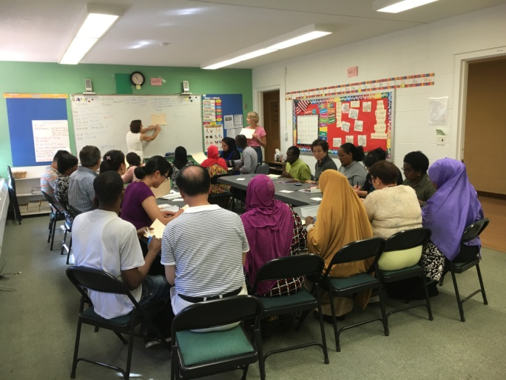
Maps and Directions
Next we gave the students directions for placing their building on their own maps. The goal was to understand verbal directions and place the buildings on a map. Finally students partnered and had to tell their partner where to place each building on the map.

Slide 21
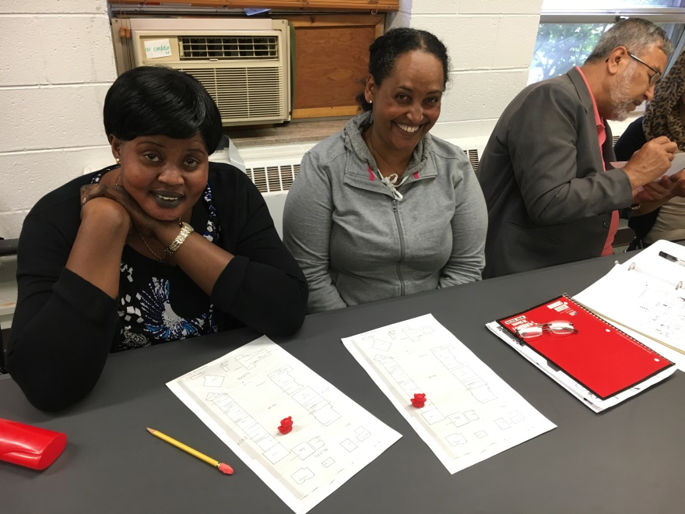
Transportation
Another scaffolded lesson …
This time in preparation for a field trip to a local shopping center we used a map of the shopping center and had students become familiar with the store names and locations. Each student had a plastic bear and were asked to follow the verbal directions to reach a destination on their map. This activity built on the previous weeks’ skills.

Slide 22
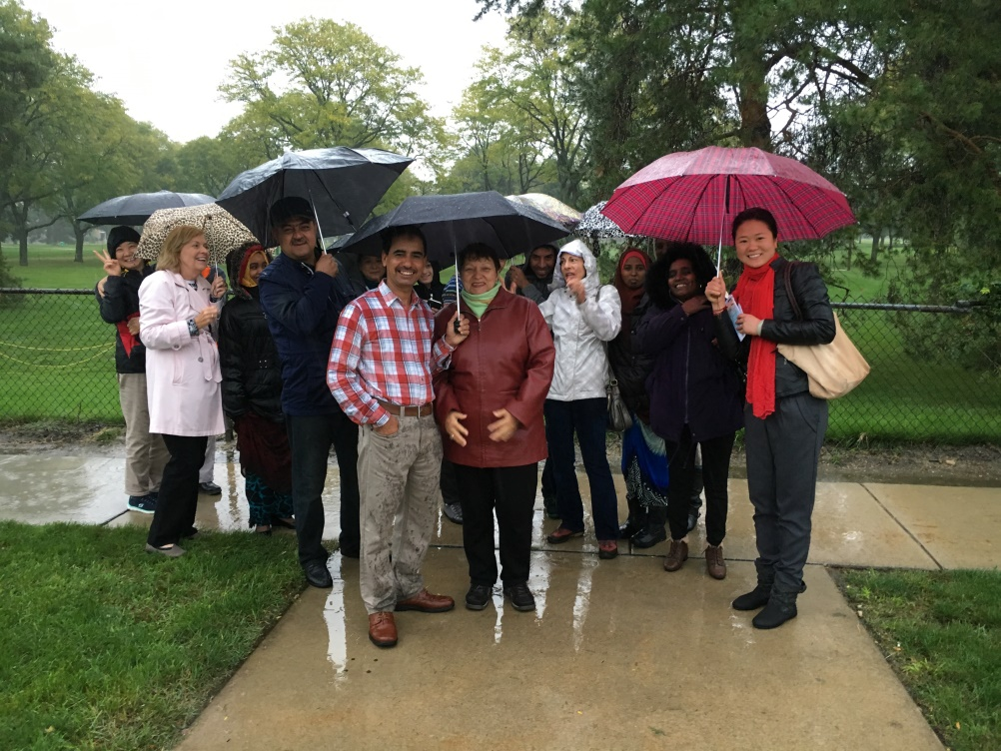
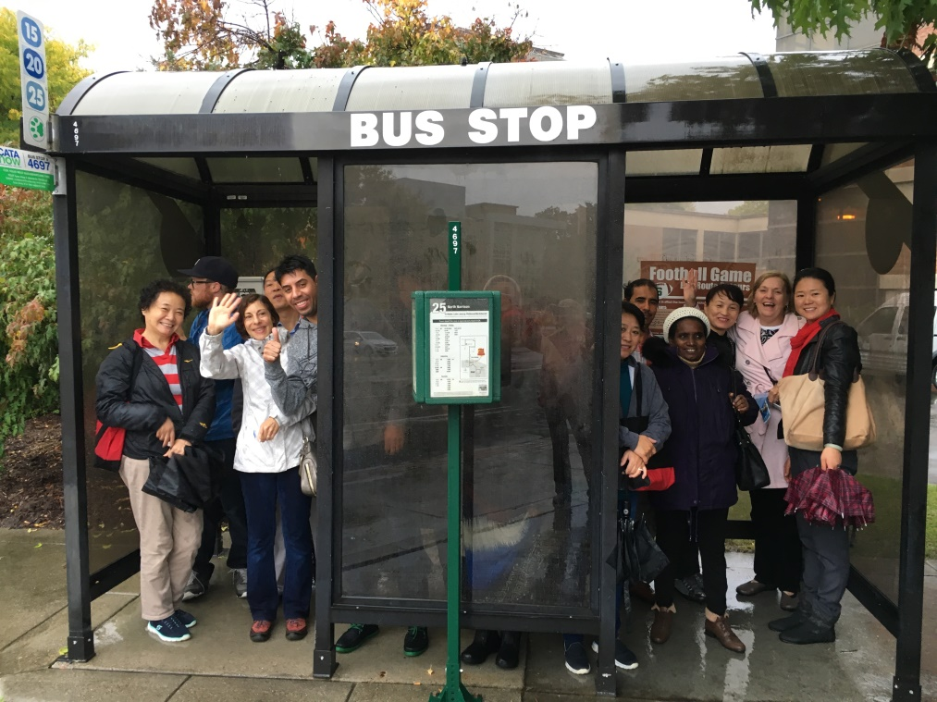
Transportation
After practicing reading a bus schedule and discussing the route and times with the Team Group we took the CATA bus to the shopping center. We waited at bus stops for the scheduled arrival and departure of our bus and also made bus transfers. (ALL IN THE POURING RAIN!)

Slide 23
Transportation

Slide 24
Transportation
Once we arrived the students had the opportunity to explore the different shops that had been described on the maps used earlier in the classroom. It provided many opportunities to reinforce directional vocabulary as well.

Slide 25
Transportation
This was the real life culmination of the previous three weeks of classroom learning.

Slide 26
Some Final Thoughts
As you get in the teaming mode and as you plan for your own classroom lessons you will intentionally start thinking of activities to use for your team lessons each week.
Bring these ideas to your team planning time.
Vary the activities in your team teaching from week to week.
HAVE FUN and watch the smiles on your students’ faces!☺
Team Time will be a highlight in their week!

Slide 27
Questions

Slide 28
Jump In!
Rational…Why do we want to team teach? What do we see as benefits for our ESL students?
Think about our weekly schedule. Identify 1-2 times during the week we could team teach.
What topic are we teaching next week?
What common skills do we want to team teach with our topic? (CCRS standards)
Brainstorm ideas for interactive activities that we could do together with our classes.
Areas to consider: speaking/conversation, asking and answering questions, listening, practicing new vocabulary, reading, writing and/or grammar. (You may need to look through your curriculum materials to spark ideas).

